Slide 1

Our Platform
An Internal Conversation…
…an External Experiment
Jeffrey McLarty
Annual General Meeting
November 4th 2012

Slide 2

Five Succinct Planks
Problem Statement
Short term ideas (practical)
Long term ideas (principled)
Facts
Talking Points
Guidance for Candidates

Slide 3
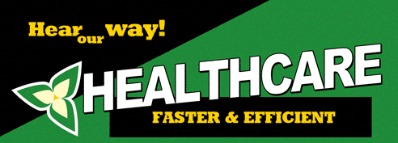
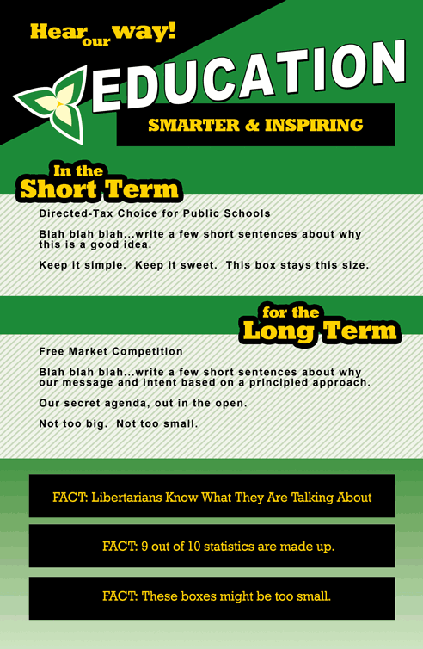
DRAFT
Short Term Focus: More Options
Allow Innovation
  Reduce regulation’s on new treatments ➔ Replace with warnings
Multi-level Insurance
  Force Plan Participation ➔ Choice of 92 competing insurers
Long Term Focus: Shorter Wait Times
Competitive Service Model
  Charge extra for better service ➔ More doctors, shorter lines for all
Stimulate Voluntary Support
  Rely more on charity of friends & family ➔ Less of a burden on society

Slide 4
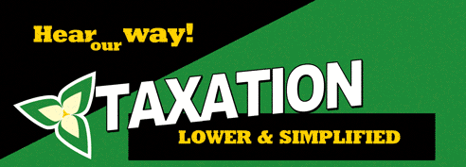
DRAFT
Short Term Focus: More Freedom
Lower Income Taxes, HST and Gasoline Tax
  Reduce each income tax tier rate by 10% ➔ Lower income taxes for everybody
  Reduce HST from 13% to 10% ➔ Lower the price of almost everything by approximately 3%
  Reduce Gasoline Tax from $0.147 to $0.097/L ➔ Lower price of gas by $0.05/L
Close Tax Loopholes
Long Term Focus: Less Stress
Sole Flat Rate Income Tax
  Constant Percentage of Income & Capital Gains ➔ Simple, like Alberta
End all other taxes
  End HST ➔ No more hassle & confusion for businesses
  End Corporate Taxes ➔ Corporations don’t use hospitals or schools

Slide 5
DRAFT
Short Term Focus: More Choice
Home Schooling Tax Breaks
Directed-Tax Choice for All Public Schools
  Parents Choose School & Tax Dollars Follow ➔ Improvements abound
  Treat Public Schools similar to Separate Catholic Schools
Privatize Religious Public Schools
  Give them freedom ➔ Teach who and what they want, without public funds
  No more special treatment for a single religion
  Reduce financial burden & risk for Ontario
Long Term Focus: More Quality
Privatize All Public Schools
  Give them freedom ➔ Options, innovation, salaries & schedules.
Eliminate Interference
  Legalize information transfer ➔ Do not dictate curriculum, testing methods, technologies.

Slide 6
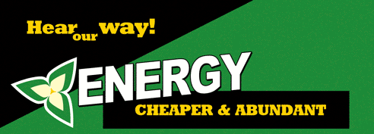
DRAFT
Short Term Focus: More Sustainable
Stop Subsidizing Solar & Wind
  Stop FIT & MicroFIT ➔ Market will build most efficient alternatives
Stop Risky Energy Programs
  Let the Market Test New Technologies ➔ Smart Meters, smart grid and other risky technology bets are not appropriate for tax dollars.
  Undo Regulated Plan Program
Long Term Focus: Lower Bills
End Corporate Handouts & Bailouts
  Do not renew contracts & programs ➔ No more importing cheap power, and buying expensive power.
Privatize Energy All Production
  Sell Ontario Power Generation ➔ Reduce Debt & Risk

Slide 7
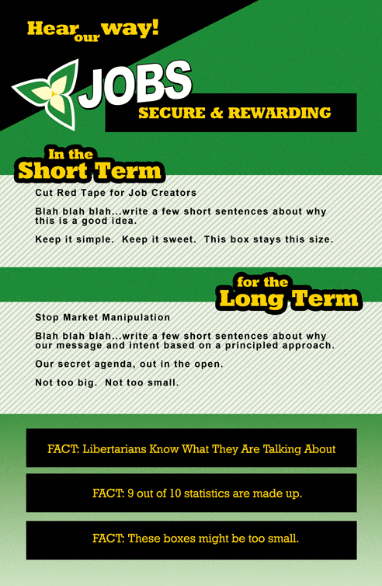
DRAFT
Short Term Focus: More Opportunity
Cut Red Tape for Job Creators
  Remove Obstacles ➔ Wages & Training requirements should be determined by the employee & employer
Grant “Right to Work”
  Enable Non-Unionized Workers to fill public unionized jobs ➔ Benefits employers, employees and taxpayers
Long Term Focus: Greater Prosperity
Improve Regulatory Environment
  Reduce Interference ➔ Licensing, Funding Support, Insurance Requirements, all interfere with greater prosperity.

